Slide 1



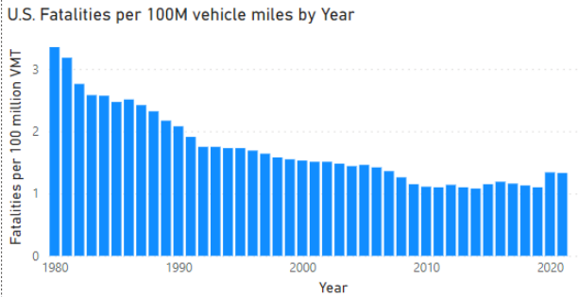
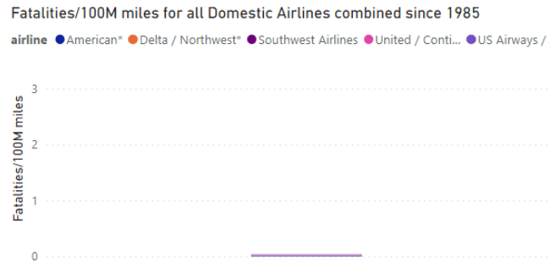
People drive
8x more miles
than they fly!
Be SMART this holiday season:
When feasible, FLY to your destination instead of driving!
But flying is
20x safer
than driving!
And even though auto fatality rates
Deaths per 100,000,000 miles
of flying from 1985 – 2015:
Almost 0!
have been decreasing for decades…
Sources: NTSB

